Slide 1
Business Process Engineering
Week 09

Slide 2
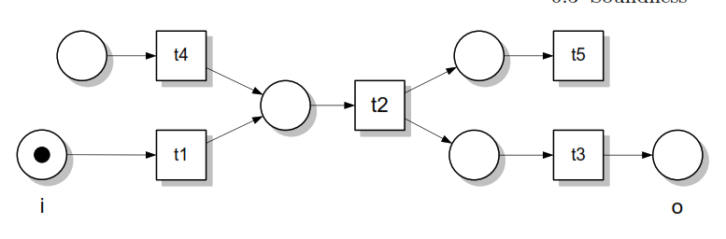
Structural Soundness
Structural errors.
Process models represented using process orchestration languages
Structural errors are represented uses Petri nets, in most cases, workﬂow nets.

Slide 3
Soundness assume that a process is structurally sound.
A process model is structurally sound if the criterion that a process model should fulfill. following
conditions hold:
There is exactly one initial node, which is only node without any incoming edges. (i)
There is exactly one final node, which is only node without any outgoing edges. (o)
Each node in the process model is on a path from the initial node to the final node. (i) to (o)

Slide 4
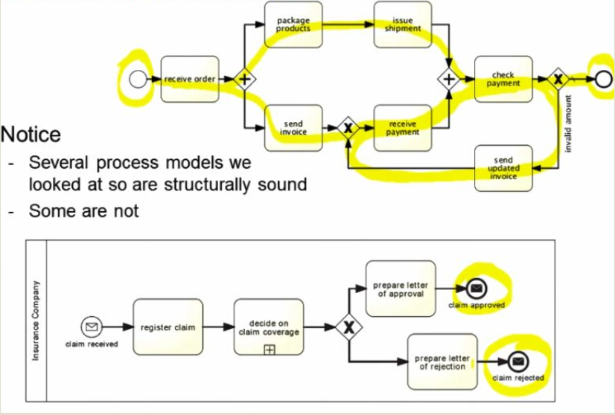

Slide 5
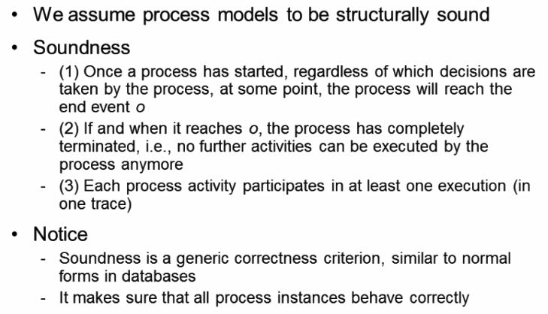
Soundness criterion

Slide 6
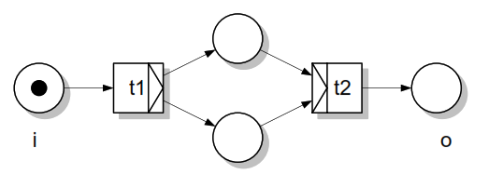
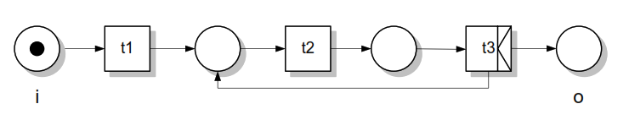
Deadlocks and Livelocks

Slide 7
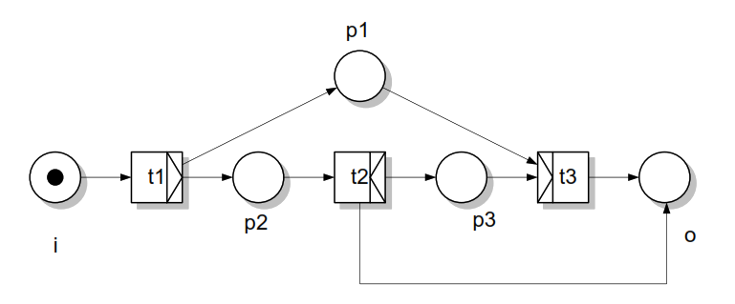

Slide 8
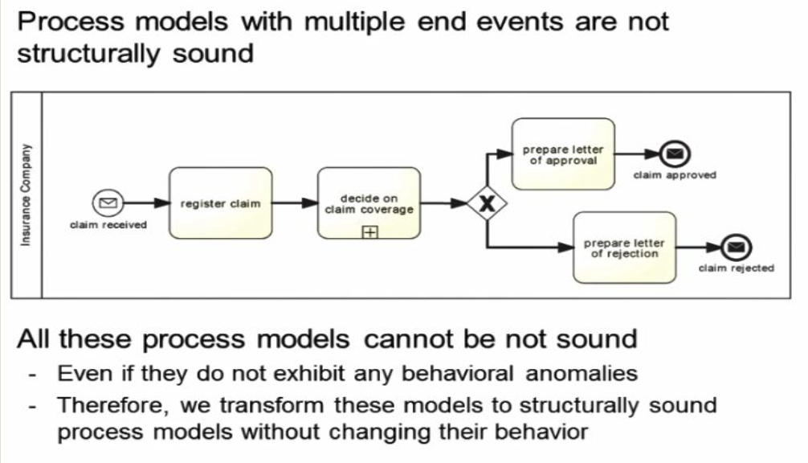

Slide 9
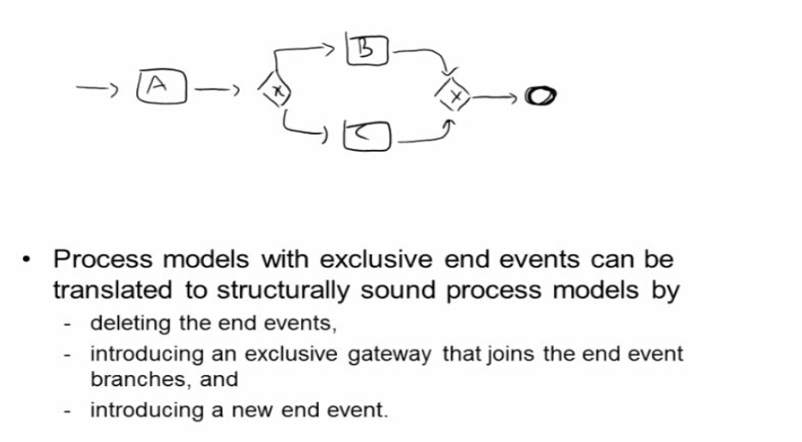
To start formal analysis
Now we transform the structurally unsound process into structurally sound process.

Slide 10
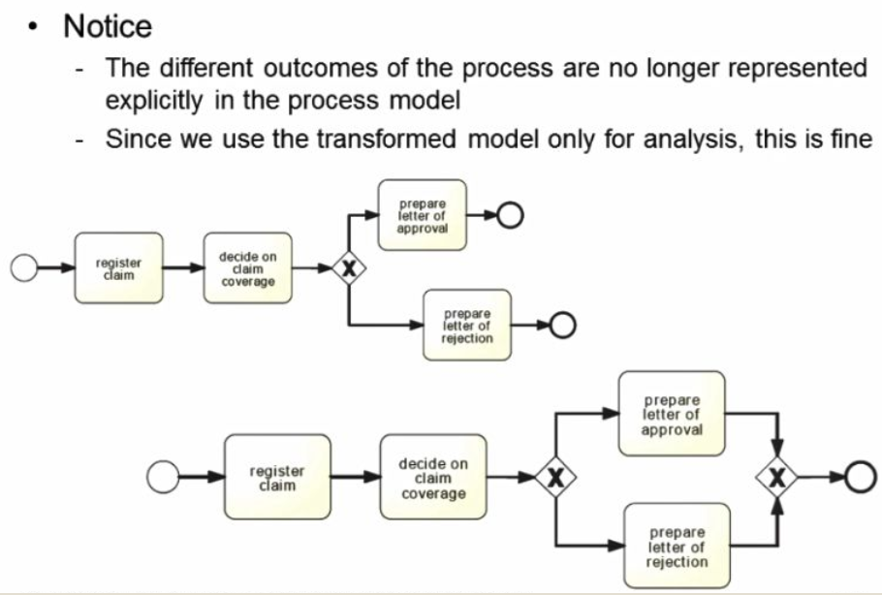

Slide 11
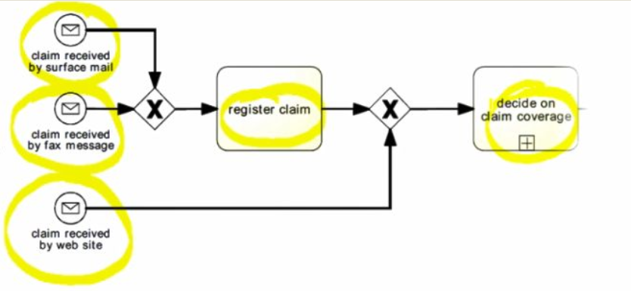

Slide 12
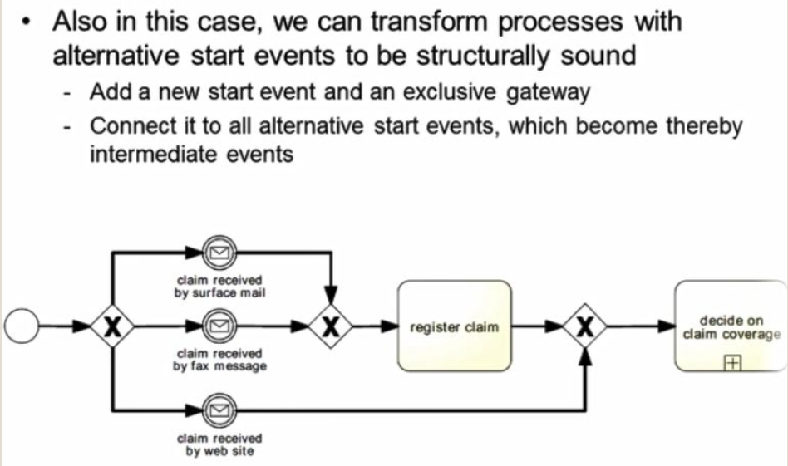

Slide 13
